Slide 1
Navigation page
Axon sales
About sales
About customers and employees
About top customers and top employees

Slide 2

Axon Sales Analysis
Key Insights :
Total sales was $9.6 Million with in this three years
Number of Orders 326 placed by 273 customers
All achievements were done with 23 employees
Highest number of orders Placed on 4th quarter of 2004 which was near Christmas time
Highest Profits in the 3 years were made in 2004
USA was the top country to place orders

Slide 3
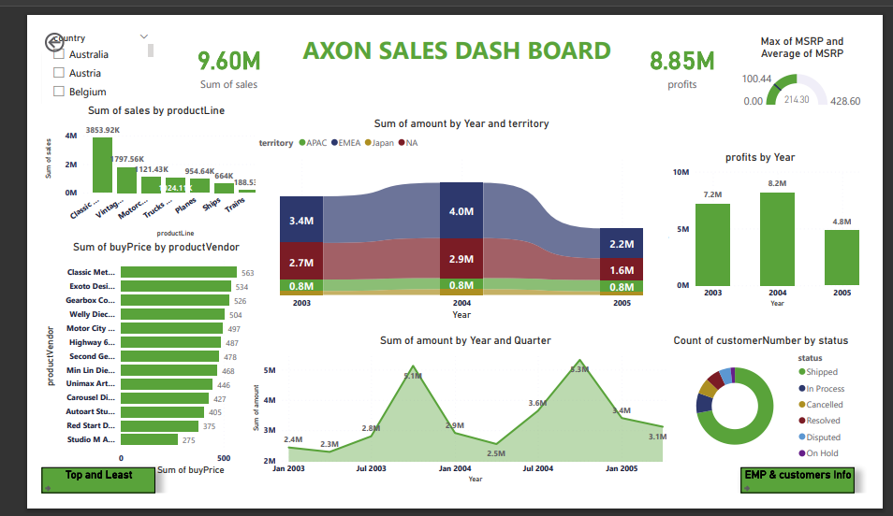
Key Points: Here you can see sales by Product line classic cars were the top sold item in this three (2003-2005) years. Top product vendor as per buying price wise Classic Metal creations. As per the below line, chart revenue was high in fourth quarter of 2003 and 2005. Territory wise EMEA consistently maintained top position remaining as follows. Most of the orders were shipped and few items were cancelled or on hold. Profits were high in 2004 at a total of $8.2 million Despite this, the products never reached their Max MSRP In summary, 2004 was best year as per profit, sales and revenue.

Slide 4
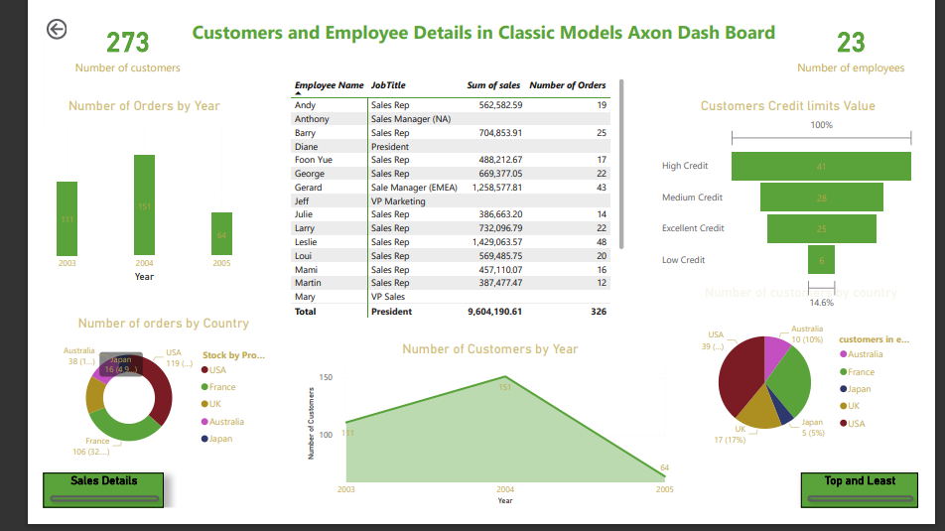
Key Points about customers and employees: In the organization 23 employees were working to serve 273 customers. In 2004, 151 orders were placed followed by 2003 and 2005. Most of the orders were from USA and then France was in second highest. As per data 2004 was the most welcomed year for new customers 40% of the customers came from USA, followed by 30% from France, UK ,Australia and Japan. Most of the customers maintained high credit limit , very few customers were in low credit. Some of the employees did incredible sales and handle more orders.

Slide 5
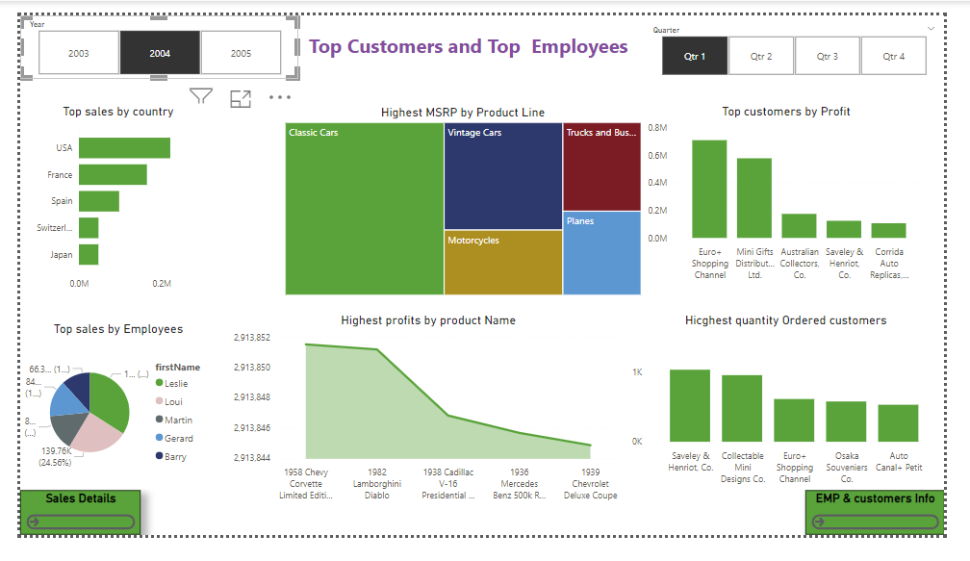
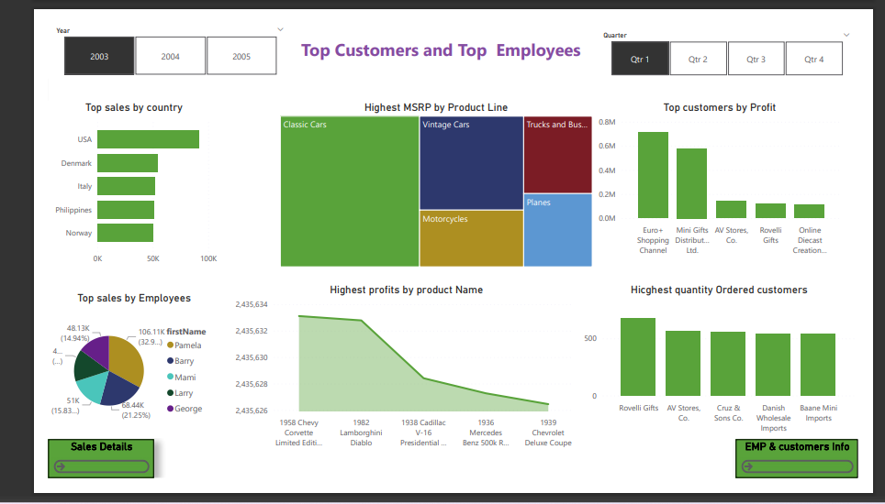
Key Points about top customers and employees: In 2003 USA was the top sales ,remaining all pretty similar Most sold item was from classic cars product line and second sold item vintage cars. Top customers as per revenue Euro Shopping channel. Highest orders received from Rovelli gifts , Highest profited product was from 1958 Chevy Crovett Limited Edition. Employees worked hard in this year was Pamela, Barry, Marri, Larry and George. In 2004 USA and France were the top sales ,remaining all lower .Most of the orders received from Saveley & Henrit Co . Most sales made by these Employees Leslie, Loui, martin, Gerard and Barry. In 2005 Most of the sold products and country was same as Previous year ,but sales were pretty less and as a result less revenue and profit. Most of the orders received from Euro Plus Shopping Channel . Most sales made by these Employees Leslie , Loui ,martin, Gerard and Barry.

